Slide 1
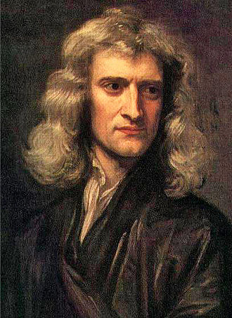
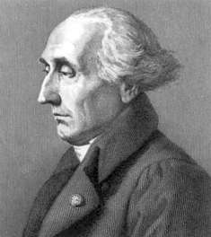
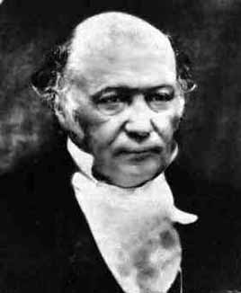
Theoretical Mechanics I
Isaac Newton
(1642-1726)
Joseph-Louis Lagrange
(1736-1813)
William Rowan Hamilton
(1805-1865)
Vectorial Mechanics
Analytical Mechanics
吳國安教授
Office - Phys 610
kuoan.wu@gmail.com
9/19/2016

Slide 2
Syllabus – 理論力學
課程用書: 筆記
參考書目:
1. “Analytical Mechanics” by L. N. Hand and J. D. Finch
2. “Mechanics” by L. D. Landau and M. Lifshitz
3. “Classical Mechanics” by H. Goldstein
4. “Classical Dynamics of Particles and Systems” by S. T. Thornton and J. B. Marion
上課時間(M3M4W2)、教室(物理館019)
演習課 (助教時間)
每週二晚上 7:00-8:30 (R504)
上課內容、作業可在
MOODLE 數位學習平台下載
http://moodle.nthu.edu.tw
Office Hour:
3:30PM - 5PM every
Wednesday in my office (R610)
評分標準:
The course grade will be composed of
Homework Sets (30%). Collaboration on homework set is encouraged, however you
must write up your own reasoning independently.
Exams: midterm (Nov. 14th - 35%) and final (Jan. 9th - 35%)
Extra Credits
助教:吳俊宏(j1995317@gmail.com)、劉明威、陳敬榮、李鴻逸

Slide 3




Overview of this course
Important Classical Systems
Lecture 4 — Oscillation
SHO、Damped Oscillation、
Forced Oscillation、
Coupled Oscillation、Resonance
Analytical Mechanics —
Lagrangian Mechanics
Principle of Least Action
Variational Calculus
Euler-Lagrange Equation
(Lecture 2、3)
Newtonian Mechanics
(Lecture 1)
Lecture 5 — Nonlinear Dynamics
Nonlinear Oscillation
Lecture 6 — Central Force Problem
Kepler’s Laws
Rutherford Scattering
勝
Vector Mechanics!
Scalar Mechanics!
Single particle systems and
two-body systems
Analytical Mechanics Part II —
Hamiltonian Mechanics (Lecture 7 if time permits,
otherwise, we will include it in the Spring semester)
What about many-body systems,
rotational motion, special relativity,
how CM relates to E&M, QM, SP?

Slide 4
Lecture 1 – Newtonian Mechanics
Lecture 1 – Newtonian Mechanics
Review of Newton’s Laws of Motion
Inertial Frames & Galileo’s Principle of Relativity
Conservation Theorems
Conservative Forces
Review of Vector Calculus Identities
Stokes’ Theorem
Levi-Civita Symbol、Kronecker Delta Function、Einstein Summation Convention
Goldstein 1-1, 1-2

Slide 5



Newton’s Laws
Philosophiæ Naturalis Principia Mathematica, Issac Newton, 1687
Newton’s 1st Law – A body remains at rest or in uniform motion if the net force is zero.
(Law of inertia)
If
, then
Free particle moves at
a constant velocity
: Velocity of the particle
Velocity is a vector, thus for a free particle, its magnitude (speed) and direction do not change with time.
The 1st law is only true in certain set of reference frames …
frames with a set of rulers and clocks
Concept of absolute time in Newtonian mechanics
The validity of the 1st law defines “inertial frames”
In inertial frames, space is homogeneous(勻質性) and isotropic(等向性), and time is homogeneous.
Space is homogeneous – free particle acts the same way regardless of its position
(translational invariance in space).
Space is isotropic – free particle acts the same way regardless of its moving direction
(rotational invariance in space).
Time is homogeneous – free particle acts the same way regardless of time
(translational invariance in time).
The symmetry properties are extremely important as we will discuss more later in Lagrangian mechanics
Different inertial frames are moving with constant velocities relative to one another.

Slide 6


















Newton’s Laws
As an example, let’s consider a rocket in outer
space which propels itself by expelling fuels at a
constant velocity relative to the rocket.
Velocity of the rocket is represented by
Issac Newton, 1687
The rocket is subjected to an external force
The 1st law defines the inertial frames, then in the inertial frame, we introduce the 2nd law,
The mass of the rocket is m
Newton’s 2nd Law – A body acted upon by a force moves in such a manner that the time rate of
change of momentum equals the force.
Fuels are ejected at a rate of
: momentum of the particle
For a constant mass system, we can rewrite it as
is particle’s acceleration.
What if the mass of the system changes with time?
Let’s write naively the 2nd law for a variable mass
How to fix it?
Assume now the net force is zero, we obtain
In the inertial frame where the mass is relatively at rest ( ), the mass remains rest.
In other inertial frames ( ), the mass accelerates!
It contradicts with the 1st law.

Slide 7




Newton’s Laws
Issac Newton, 1687
Newton’s 1st Law – A body remains at rest or in uniform motion if the net force is zero.
If
, then
Free particle moves at
a constant velocity
: Velocity of the particle
Newton’s 2nd Law – A body acted upon by a force moves in such a manner that the time rate of
change of momentum equals the force.
: momentum of the particle
is particle’s acceleration.
Newton’s 3rd Law – If two bodies exert forces on each other, these forces are equal in magnitude
and opposite in direction (all forces exist in pairs).
m₁
m₂
: Force experienced by particle 1 due to particle 2
Validity of Newton’s laws – They’re very good approximation for daily life experiences. However, they’re
not suitable in describing situations of small scales, high speeds, and strong gravitational field.

Slide 8





Principle of Galilean Relativity
Galileo’s principle of relativity (Galilean Invariance):
Mechanical laws have the same form in all inertial frames.
Different inertial frames are moving with constant velocities relative to one another.
Inertial Frame S
Galilean’s Transformation
Galilean’s Transformation
Frame S’
(moving at constant velocity V relative to S)
At t=t’=0
Two frames coincide
At later time t=t’
If Newton’s laws are valid in one reference frame, then they are also valid in any reference frame in
uniform motion with respect to the first system
The laws of mechanics are
the same in all inertial frames

Slide 9
Lecture 1 – Newtonian Mechanics
Lecture 1 – Newtonian Mechanics
Review of Newton’s Laws of Motion
Inertial Frames & Galileo’s Principle of Relativity
Conservation Theorems
Conservative Forces
Review of Vector Calculus Identities
Stokes’ Theorem
Levi-Civita Symbol、Kronecker Delta Function、Einstein Summation Convention
Goldstein 1-1, 1-2

Slide 10











Conservation Theorem – Single Particle
Conservation Theorem for the Linear Momentum of a particle:
For a single particle, if the total force is zero, then the linear momentum is conserved.
Proof:
If total force is zero
is a constant vector
Conservation Theorem for the Angular Momentum of a particle:
For a single particle, if the total torque is zero, then the angular momentum is conserved.
Proof:
The angular momentum is defined as
Torque is defined as
If
is a constant vector

Slide 11

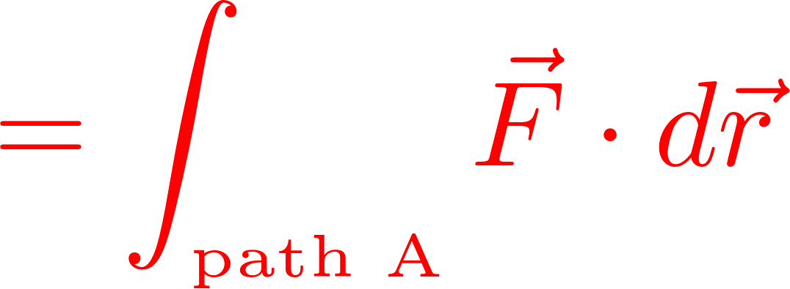
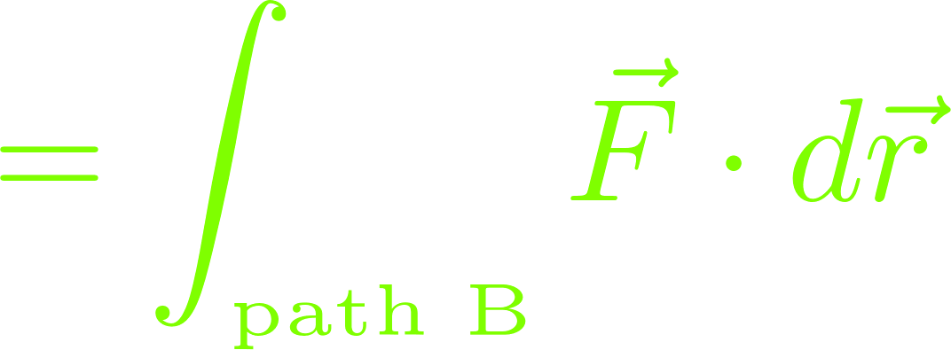





Conservation Theorem – Single Particle
Energy Conservation Theorem for a particle:
If the forces acting on a particle are conservative, then the total energy of the particle, T+U, is
conserved. T is the kinetic energy and U is the potential energy.
Conservative force: The force such that the work done by the force in moving a particle from one point
to another point is independent of the path taken.
y
Path A
2
Thus for any arbitrary closed path, the work done by the
conservative force is always zero.
1
Path B
Before we continue the derivation, let’s
review Stokes’ Theorem
x
By Stokes’ Theorem
For a conservative force, the curl of the force is zero.

Slide 12



















Stokes’ Theorem
Curl (旋度)
Stokes theorem
Del operator
Quick verification of Stokes’ theorem (for a flat 2-dimensional patch):

Slide 13




What is the meaning of curl?
Let’s say a velocity field of a flow is described by
y
y=2
y=1.5
y=1
x
Curl of a vector field is a local measurement of
the tendency to rotate.

Slide 14





Physical Meaning of Stokes’ Theorem
Let’s evaluate the path integral
is represented by the vector marked in orange
Positive curl

Slide 15
Physical Meaning of Stokes’ Theorem
Positive curl everywhere
Negative curl
Positive curl

Slide 16



Conservation Theorem – Single Particle
Energy Conservation Theorem for a particle:
If the forces acting on a particle are conservative, then the total energy of the particle, T+U, is conserved.
T is the kinetic energy and U is the potential energy.
Conservative force: The force such that the work done by the force in moving a particle from one point
to another point is independent of the path taken.
y
Path A
For a conservative force, the curl of the force is zero.
2
Mathematically, since the curl of the gradient of a scalar
function is always zero,
1
Path B
x
Then the conservative force can be expressed as the
gradient of a scalar function U (the potential energy)

Slide 17


















During the derivation, we use the fact that the curl of the gradient of a scalar
function is always zero.
Let’s review vector calculus briefly next!
Conservation Theorem – Single Particle
Any intuitive ideas?
Energy Conservation Theorem for a particle:
If the forces acting on a particle are conservative, then the total energy of the particle, T+U, is conserved.
T is the kinetic energy and U is the potential energy.
Proof:
y
Path A
2
1
Path B
The kinetic energy is defined as
x

Slide 18

















Levi-Civita Symbol
Examples:
The cross product of two vectors can be simply represented using “Levi-Civita” symbol.
In three dimensions, the Levi-Civita symbol is defined as
Let’s work out the cross product of two vectors
is unit vector

Slide 19



















Levi-Civita Symbol
Get familiar with Levi-Civita Symbol and Einstein Summation Convention,
In three dimensions, the Levi-Civita symbol is defined as
Use Einstein summation convention
(repeated index is to be summed over)
Let’s prove that
Let’s prove that

Slide 20



Levi-Civita Symbol
Kronecker delta function
In three dimensions, the Levi-Civita symbol is defined as
Useful relation between Levi-Civita symbol and Kronecker delta function
Quick Argument:
The product is non-zero only in the following two situations,
When j = m and k = n, then sign(ε_{ijk}) = sign(ε_{imn})
When j = n and k = m, then sign(ε_{ijk}) = - sign(ε_{imn})
Furthermore, we can show that
And

Slide 21





More on Vector Differential Identities
Get familiar with Levi-Civita Symbol and Einstein Summation Convention,
Now let’s work out the following identity

Slide 22















y
Conservation Theorem – A System of Particles
m_{i}
CM
Conservation Theorem for the Linear Momentum of a system of particles:
If the total external force is zero, then the total linear momentum is conserved.
Proof:
x
It is useful to introduce “center of mass” to
represent a system of particles
For each particle,
(A weighted average
of position vectors)
Summing over all particles
= 0
Newton’s 3rd law
Where we define
Equation of motion for
the center of mass
(Total external force)
if
is conserved
(Total linear momentum)

Slide 23








Conservation Theorem – A System of Particles
Conservation Theorem for Total Angular Momentum of a system of particles:
If the total external torque is zero, then the total angular momentum is conserved.
Proof:
For each particle,
Then the cross product with its position vector is
The total angular momentum is the sum
over individual angular momentum
Summing over all particles
Left hand side of the equation is

Slide 24

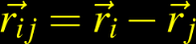









Conservation Theorem – A System of Particles
Conservation Theorem for Total Angular Momentum of a system of particles:
If the total external torque is zero, then the total angular momentum is conserved.
y
Proof:
Particle i
Particle j
x
The first term on the right hand side can be considered as the sum over all pairs of
If the internal forces between two particles also lie along the line joining the particles
(Central forces)
Then the first term on the right hand side vanishes, and the equation becomes
If the total torque is zero, then is conserved.
Total torque

Slide 25









Conservation Theorem – A System of Particles
Since we have introduced the concept of center of mass, let’s see if we can express the total angular
momentum in terms of the center of mass.
y
=0
CM
x
= 0
= 0

Slide 26











Conservation Theorem – A System of Particles
How about Energy Conservation Theorem for a system of particles?
For particles moving from initial configuration 1 to a final configuration 2, the work done by all forces is
y
Configuration 1
Configuration 2
x
Let’s take a closer look at T
T is the total kinetic energy of the system

Slide 27



















Conservation Theorem – A System of Particles
How about Energy Conservation Theorem for a system of particles?
On the other hand, for particles moving from initial configuration 1 to a final configuration 2, the work
done by all forces is
If the external forces are conservative forces
If internal forces are also conservative forces
Since the space is homogeneous, the potential only depends on the relative position vector
Since the space is isotropic, the potential does not depend on the orientation
Then Newton’s 3rd law is automatically satisfied

Slide 28
Conservation Theorem – A System of Particles
How about Energy Conservation Theorem for a system of particles?
On the other hand, for particles moving from initial configuration 1 to a final configuration 2, the work
done by all forces is
If the external forces are conservative forces
If internal forces are also conservative forces
Since the space is homogeneous, the potential only depends on the relative position vector
Since the space is isotropic, the potential does not depend on the orientation
Then Newton’s 3rd law is automatically satisfied

Slide 29








Finally, we obtain
Conservation Theorem – A System of Particles
How about Energy Conservation Theorem for a system of particles?
On the other hand, for particles moving from initial configuration 1 to a final configuration 2, the work
done by all forces is
If the external forces are conservative forces
If internal forces are also conservative forces
Then we can simplify the integral of the internal work a bit

Slide 30





Conservation Theorem – A System of Particles
How about Energy Conservation Theorem for a system of particles?
Quick summary -
For both external forces and internal forces being conservative, the total energy of the system,
T+U, is conserved.
What if there are non-conservative forces involved? (such as frictional forces)
For example, there are non-conservative external forces acting upon the system,
Repeat the same calculation, we obtain

Slide 31


Lecture 1 – Newtonian Mechanics
Review of Newton’s Laws of Motion
Inertial Frame & Galileo’s Principle of Relativity
Conservation Theorems
Single Particle
Group of Particles
Conservative Forces
Review of Vector Calculus Identities
Stokes’ Theorem
Levi-Civita Symbol、Kronecker Delta
Function、Einstein Summation Convention
Homework 1 due Oct. 5th (Wednesday) in class

